Slide 1

AJAX

Slide 2
What is the meaning of Ajax?

Slide 3



Slide 4
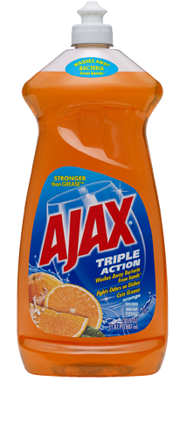

Slide 5
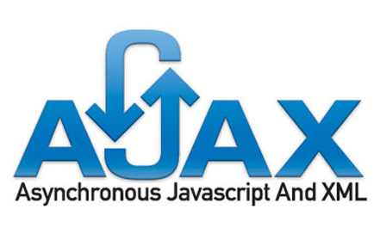
We mean

Slide 6


Slide 7
For years, Web development has required a radically different set of skills (such as HTML, JavaScript, DOM, and CSS)
ASP.NET also has the merit of bringing a new family of developers to the arena of building Web applications.
With ASP.NET, building Web applications has become a matter of doing plain old programming with a first-class language such as C#

Slide 8
Which make the web applications differs from desktop applications
the HTTP protocol is stateless, which means that each request is not related to the next and no state is automatically maintained, neither on the client nor on the server

Slide 9
CLIENT SIDE CODE
ASP.NET
JSF
PHP
Python
NodeJS
HTML
CSS
JavaScript
SERVER SIDE CODE

Slide 10



View State
Session
Cookies
Query String
HTTP Request
HTTP Response
STATELESS PROTOCOL
Notes:
Every thing it save through messages

Slide 11
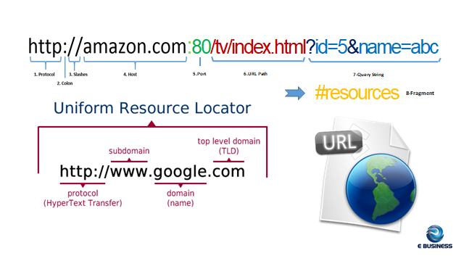
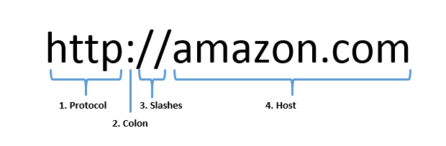
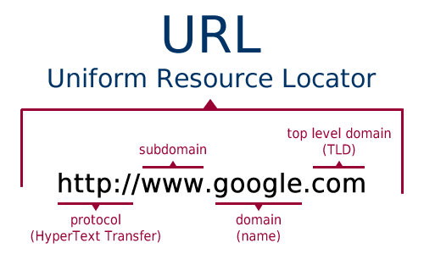

:80/tv/index.html?id=5&name=abc
5.Port
6.URL Path
7-Query String
#resources
8-Fragment

Slide 12
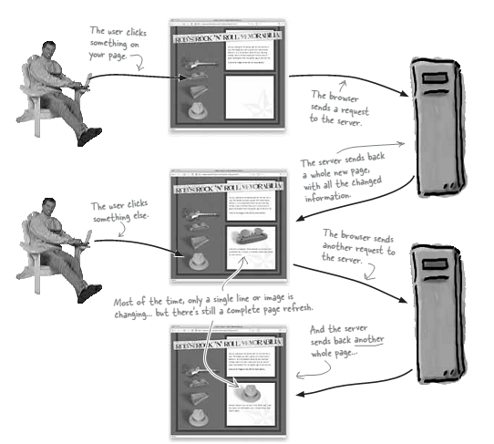
Click and Wait Pattern(bad UX)

Slide 13

Ajax
With AJAX, when you hit submit, JavaScript will make a request to the server, interpret the results, and update the current screen. In the purest sense, the user would never know that anything was even transmitted to the server.
A user can continue to use the application while the client program requests information from the server in the background.
JavaScript to make everything happens
Notes:
async js and xml
it`s not a language it`s not a framework
or a library
it`s a set of web technology to send and receive
data from a client to server asynchronously
so it`s all done behind the scenes
without having to explicitly reload the web page
xml is rarely used in ajax anymore
is not used json is replaced it
it's easier and faster and it's much more
popular
so most of the API is if you`re working with
external api`s you're probably going
to be working with json not xml
or maybe both sometimes these external
api's will return both if needed alright
and ajax can aslo just work with plain text

Slide 14
XMLHttpRequest
is an API that provides client functionality for transferring data between a client and a server.
it provides an easy way to retrieve data from a URL without having to do a full page refresh.

Slide 15

Let’s Start

Slide 16
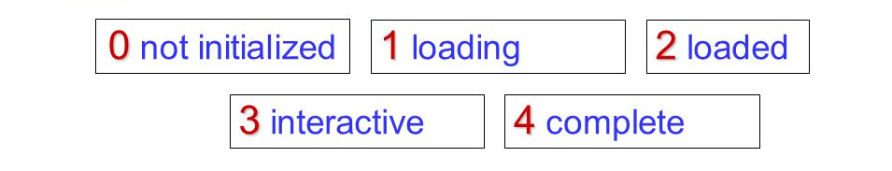
XMLHttpRequest States

Slide 17
JQuery Ajax
$.ajax(
{
url: "https://reqres.in/api/users",
type: "POST",
success: function(response){
}
});

